Slide 1
Harlow info
The
Spring 1 e-News 20.02.2025
Busy Bees
We are only halfway through the spring term and, whilst we’re still waiting for some spring-like weather, we have been as busy as the bees will be when the warm sun eventually arrives.
In the last 6 weeks, amongst all the sporting activity, staff have organised World Religion Day, a visit from a professional author/illustrator, a Stone Age day for Year 3, visits out of school for Year 1, 2 and 4, a new KS2 steel pan band, and Family Learning sessions for parents/carers. Read on for more about some of these activities but also visit our website at:
www.harlowgreen.org
Growing happy, healthy and successful, together.

Slide 2
Notices
Open Evenings
Open evenings for parents/carers are scheduled for week beginning Monday 10th March.
This will be an important opportunity for teachers and parents/carers to share information and for the children’s work to be presented.
World Book Day 2025
We will celebrate World Book Day on Friday 7th March which is the first Friday after half term.
Information has been provided regarding what the children will be involved in, and we hope that it will be an enjoyable day which supports everyone to engage in reading and books.
Message from Year 6 Head Children
It has been a brilliant new term for the children, even if the weather has not been so brilliant. The gloomy weather has not stopped many fun activities taking place which you can read about in this newsletter or on our website. When they arrived back in January, lots of the Year 6 New Year’s resolutions were to work their hardest and to maintain a positive attitude and this has definitely been achieved!

Slide 3
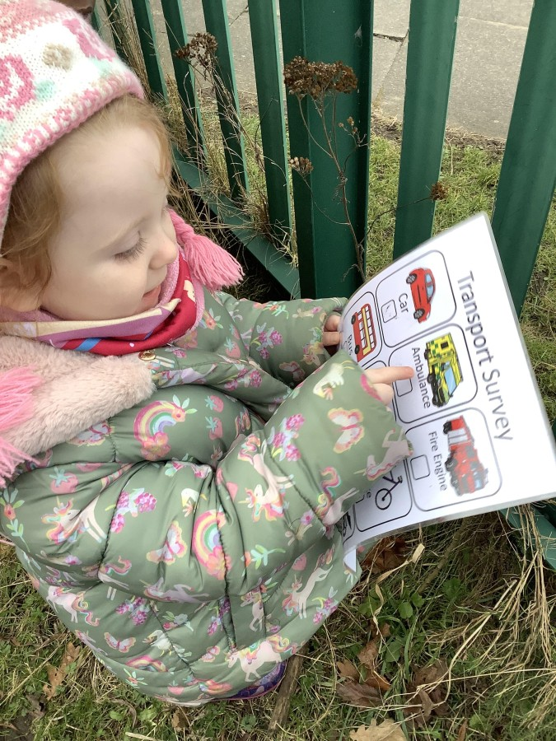
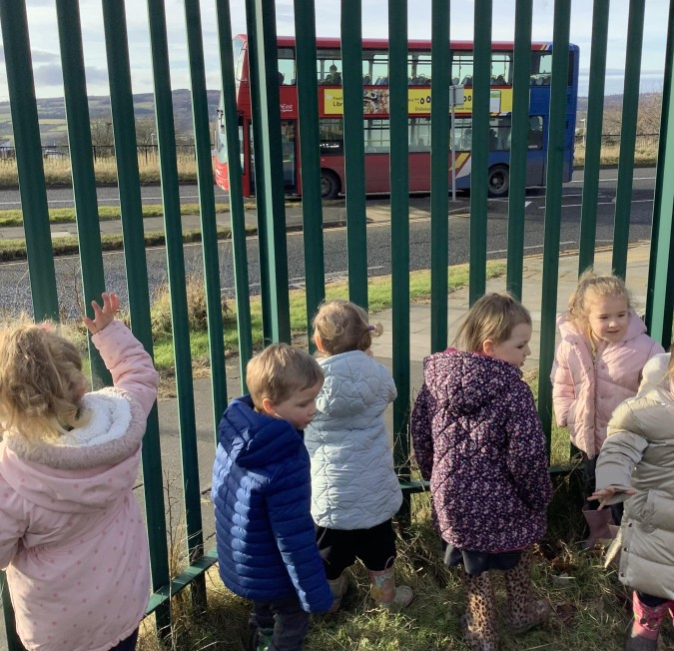
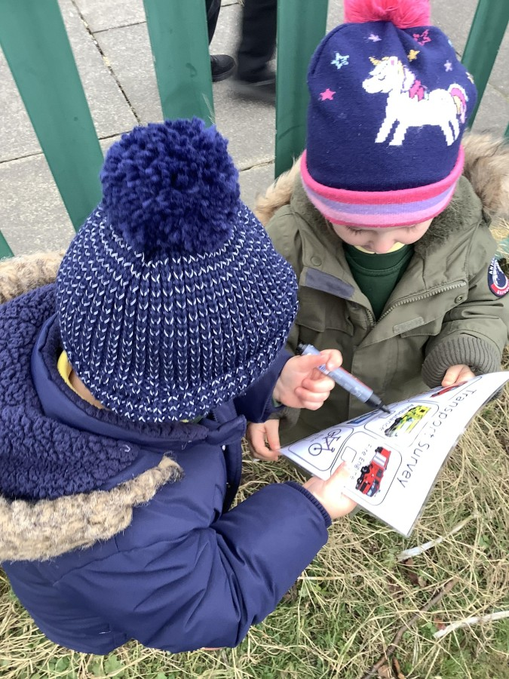
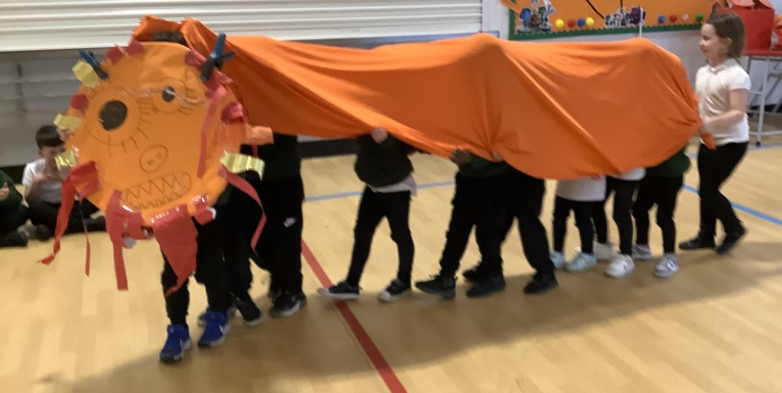
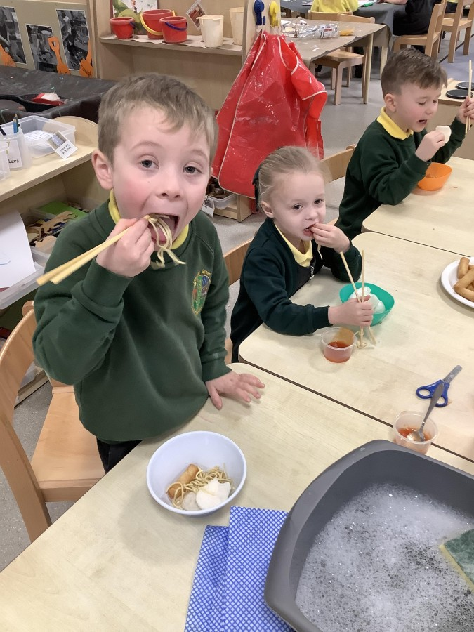
Early Years
Nursery – Terrific Transport
Children had fun conducting a transport survey in our local area during which they saw cars, buses, a motorbike, bikes, pushchairs, an aeroplane, a police van, an ambulance, lorries and vans, bin wagons, taxis, and a crane. Wow … that is
a lot of different vehicles!
Reception – Chinese New Year
Learning about other cultures is important, and Reception loved finding out about Chinese New Year. They used chopsticks to eat noodles, spring rolls and prawn crackers, but also took part in a lion dance and a lantern parade. These were great experiences, especially when we had a parent expert to help us!

Slide 4
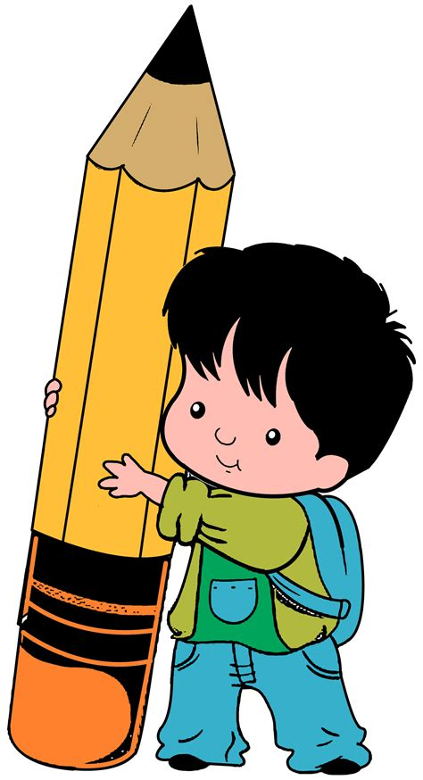
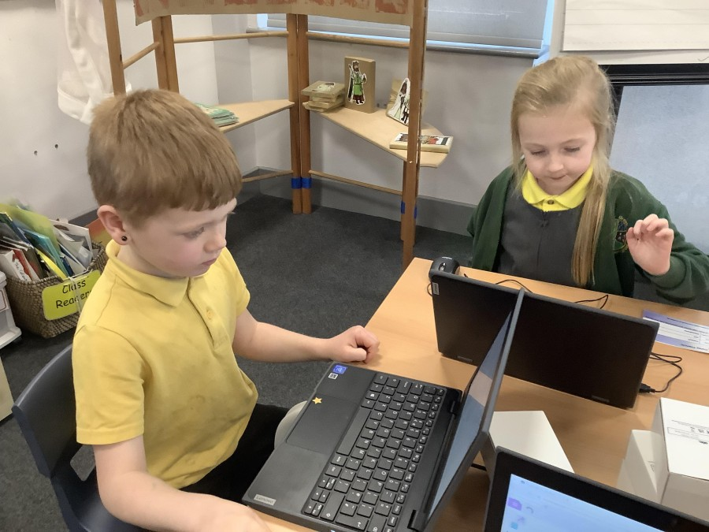
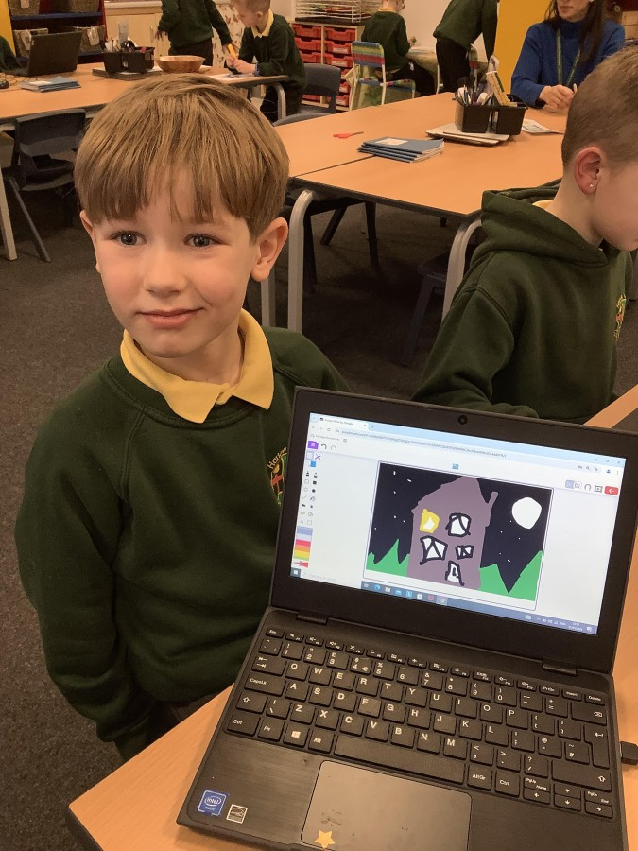
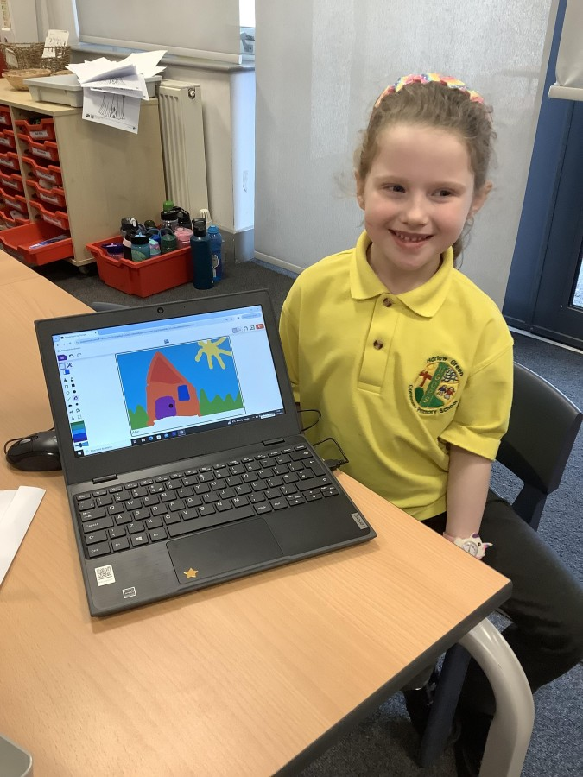
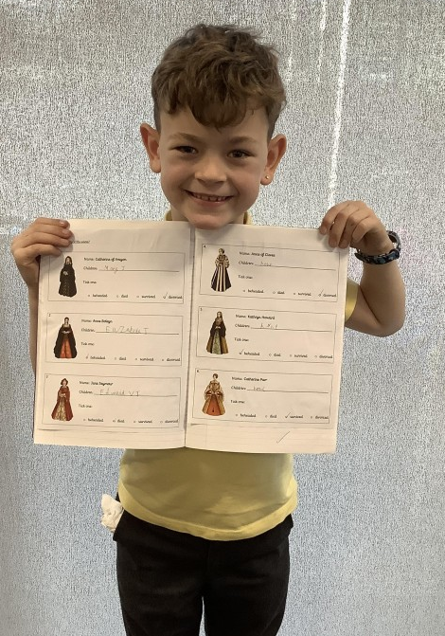
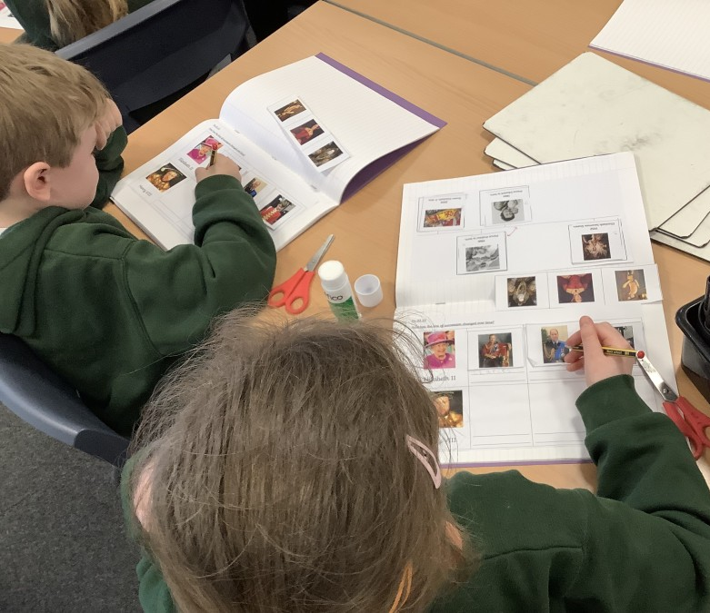
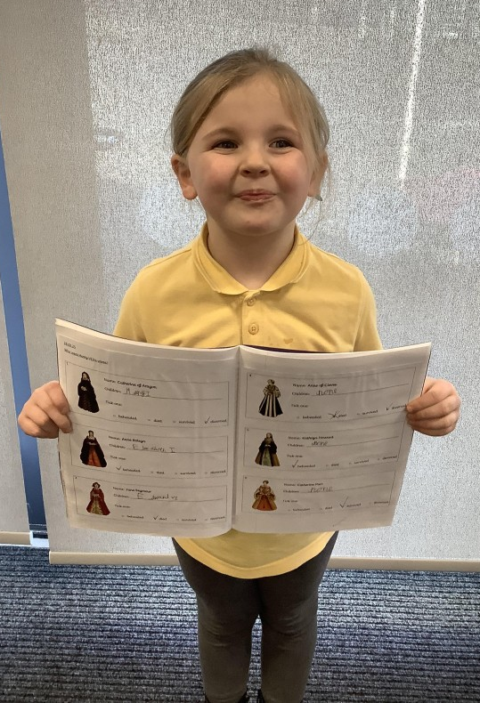
Key Stage 1
Year 1 – IT Experts
The children in Year 1 had the opportunity to use laptops in their computing sessions, this half term. They learned how to log on to the device and the software, using the tracker pad and keyboard. This allowed them to use the paint program to create paintings of houses just
like a real designer.
Year 2 – Mighty Monarchs
In History, Year 2 have been learning about two of the most influential kings and queens of England – Henry VIII and Elizabeth II. The two monarchs lived in very different times, so it has been really interesting to learn about the similarities and differences
between the two.

Slide 5
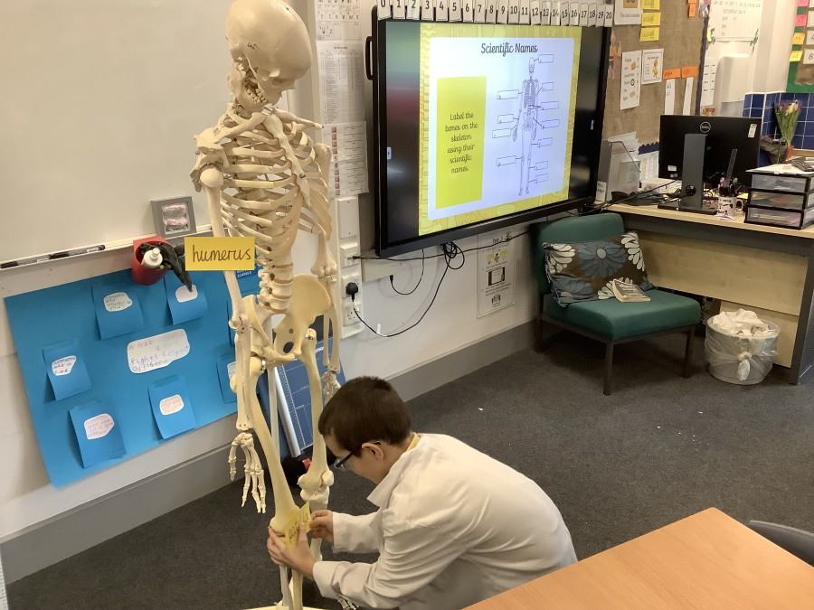
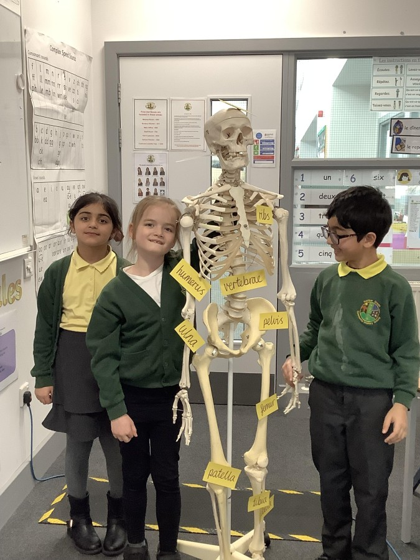
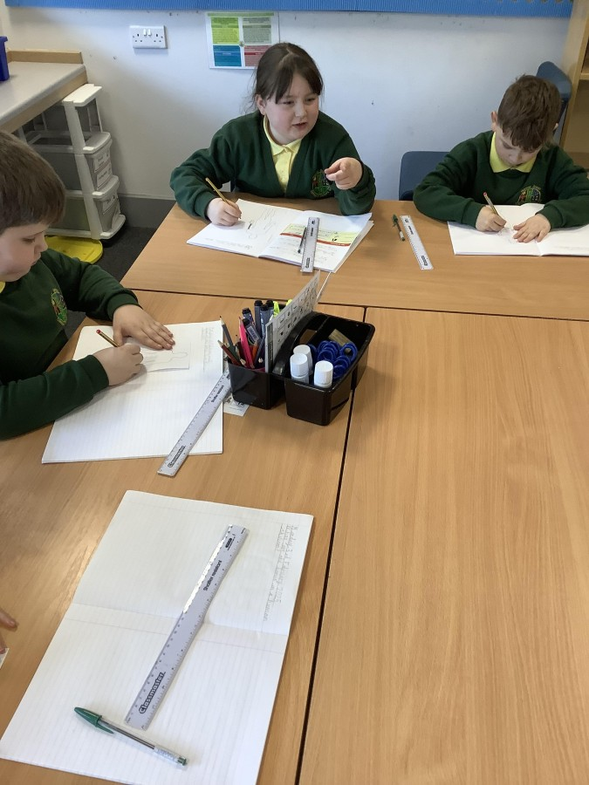
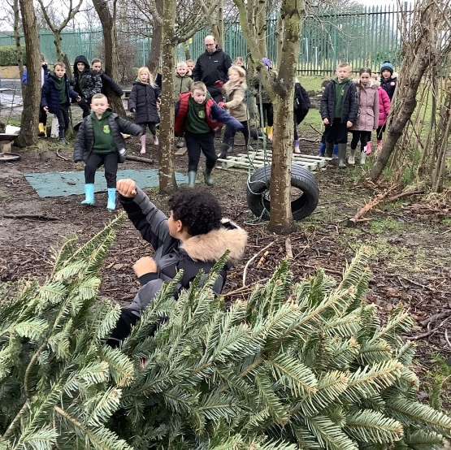
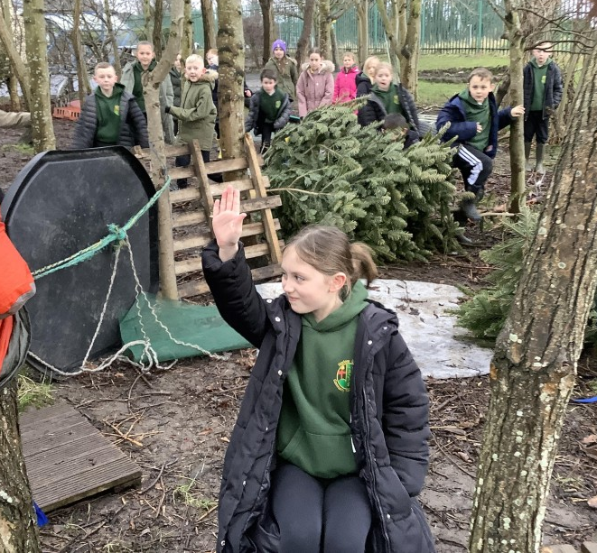
Lower Key Stage 2
Year 3 – Skeletons
What do we look like on the inside? Well, the children in Year 3 had the opportunity to get a glimpse into this when they studied skeletons in their science sessions. It was like learning to be a doctor developing expertise of the types of skeletons
and being able to name main bones!
Year 4 – Predators
In forest school, Year 4 have been learning about predators and hunting. Considering kestrels and mice, the children played the role of prey to understand the need to protect yourself when danger is immanent. Everyone learnt that, as part of an animal’s camouflage, stillness is
essential when trying to evade.

Slide 6
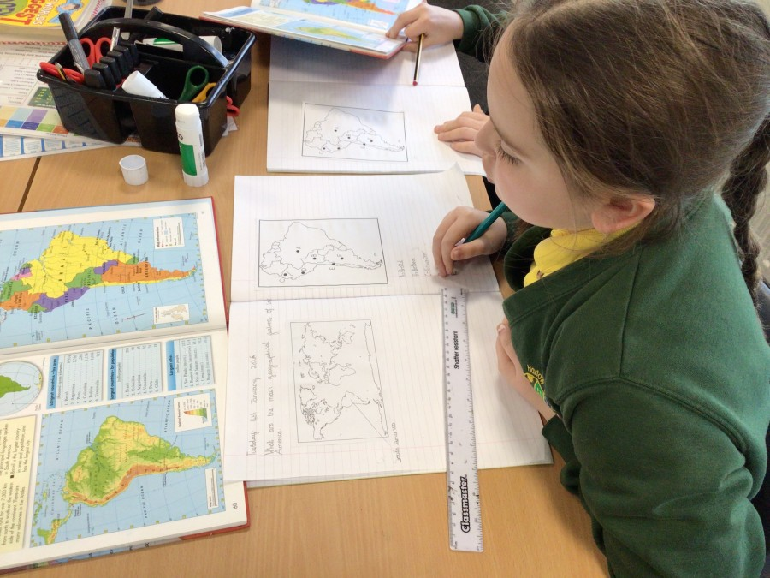
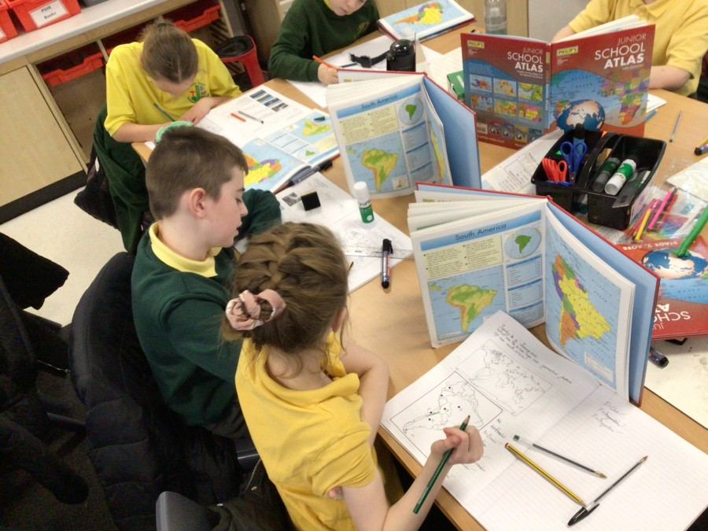
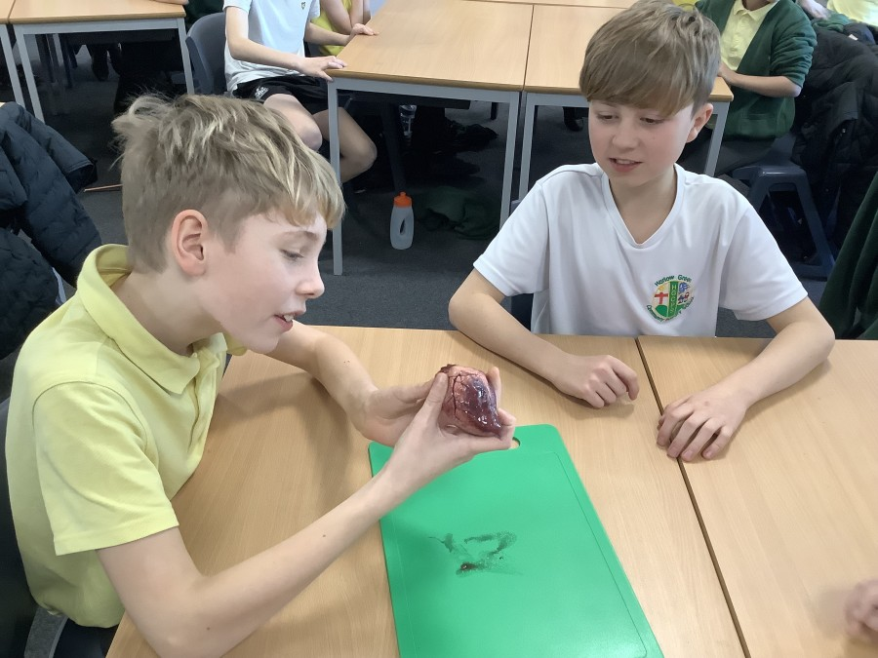
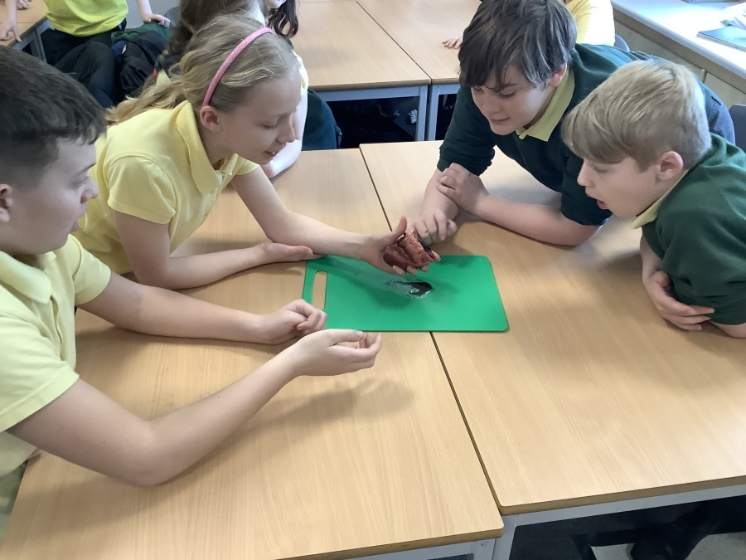
Upper Key Stage 2
Year 5 – Super South America
As part of their topic ‘Life in the Rain Forest’, Year 5 needed to develop their geographical knowledge of the continent of South America. Using atlases, the children identified South American countries as well as some of the physical features such as the Amazon and, of course, the rain forest!
Year 6 – Beating Hearts
There was more medical knowledge being developed in Year 6 science when the children learned about the heart. Developing knowledge about how the heart functions to keep us alive was made more realistic with the opportunity to handle lambs’ hearts. These were very different to the hearts we
see on Valentine’s Day!

Slide 7
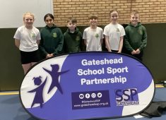
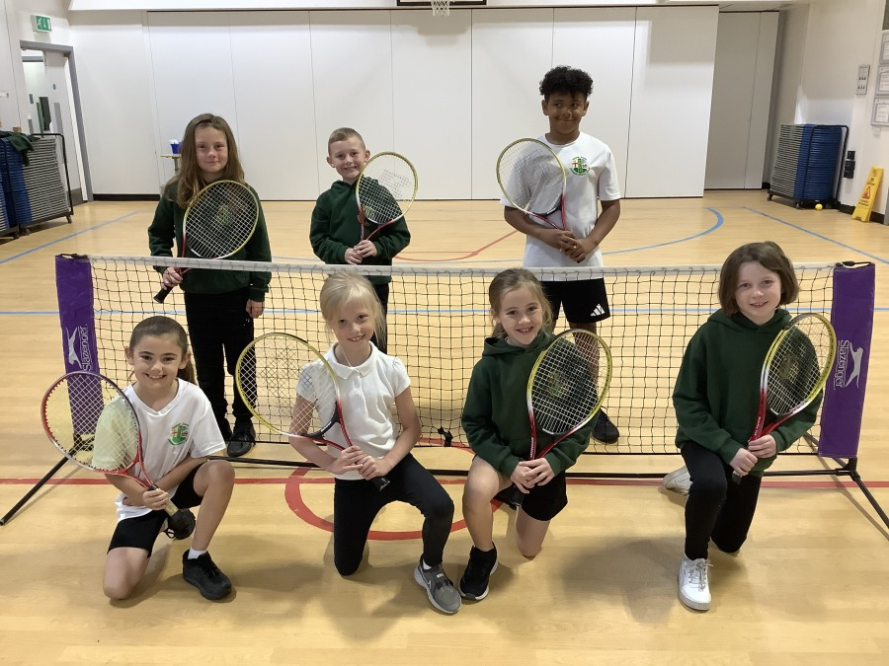
Sports Update
Hi-5 Netball
Our Year 5 and 6 Netball team took part in the Gateshead Finals which was held at Gateshead Stadium. The amazing teamwork continued from throughout with everyone
giving it their all which resulted in a joint third-place finish overall.
Year 4 Tennis Club
The Year 4 Tennis Team have continued to work hard in their training this half term with an eye towards the summer term competition. Over the last 5 weeks, the children have moved from a sponge ball to the heavier mini-orange
ball which will be used when playing outdoors in the warmer weather. Although a little trickier, it has still been fun to play!
Dance Festival
Miss Bradshaw and Mr Hollingworth have begun training a very large group of KS2 children in preparation for this year’s Dance Festival. Everyone has worked extremely hard to begin learning the routine but there’s plenty of practice to put it!

Slide 8
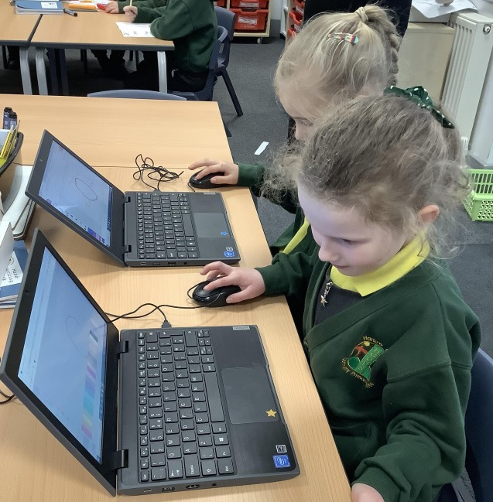
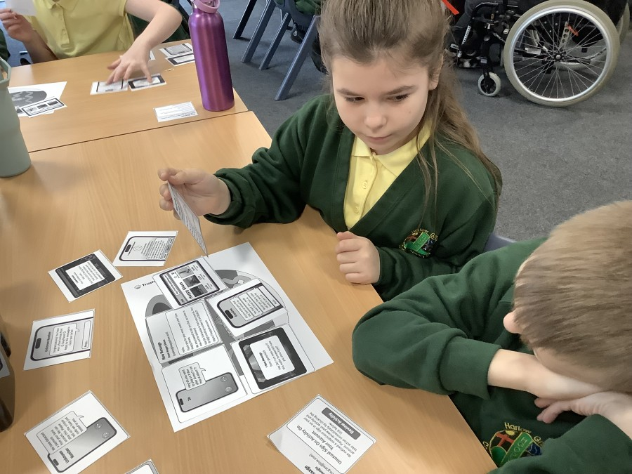
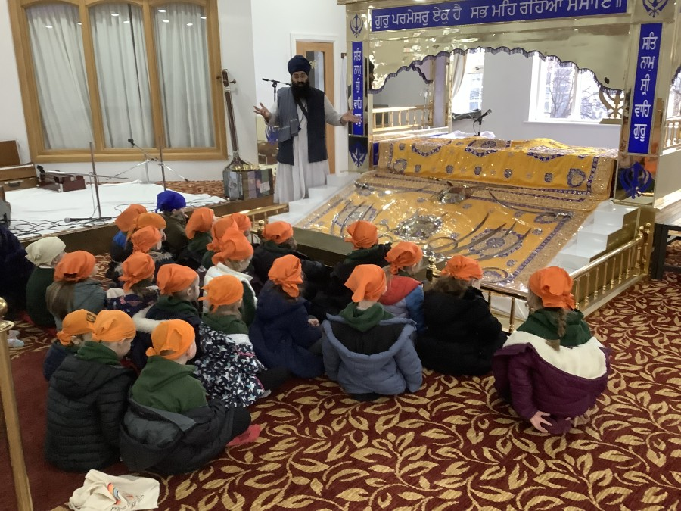
Whole School Events
Internet Safety Day
On Tuesday, 11th February, Harlow Green Primary School joined thousands of schools across the country in celebrating Safer Internet Day 2025. This year’s theme, ‘Too Good to be True’, encouraged our children to think critically about what they see online, particularly regarding scams, misinformation, and false promises.
World Religion Day
World Religion Day falls on the third Sunday in January each year. The day is an opportunity to promote understanding and peace between all religions. As a way of celebrating the day, the boys and girls at Harlow Green have all been learning about the Sikh faith.
Throughout the school, there was a lovely atmosphere as children participated in a range of activities to develop their knowledge.

Slide 9
Attendance
The highest attendance this term has been for Year 4 with a fantastic 96.5%.
02/09/24-14/02/25
Rec | 92.6%
Year 1 | 95.1%
Year 2 | 94.8%
Year 3 | 94.2%
Year 4 | 96.5%
Year 5 | 93.2%
Year 6 | 94.5%
All | 94.4%
209 children
attended for 96%
or above
44 children still have 100% attendance

Slide 10
Coming soon …
Extra-Curricular Clubs Spring 2
Club | Morning | Afternoon
Monday | KS2 Hockey Team | Year 4 Multisports
 |  | Year 6 Computing
Tuesday | Dance Festival Rehearsals | KS2 Choir
 |  | Rights Respect Club
 |  | Year 2B Art
 |  | KS2 Steel Pan Band
 |  | Year 3/4 Football
Wednesday | School Football Team
Thursday | 4/5/6 Girls Football | Dance Festival Rehearsal
 |  | UKS2 Guitar
 |  | Year 4 Spanish Club
Friday | Year 4 Tennis
We can’t tell you about everything that is going on but ...
Remember, the events and club calendar can be accessed on the School Ping app.
Some Important Dates
Date | Event | Group
21/02/2025 | Last Day of Spring 1 | All
24-28/02/25 | Half Term | All
7/03/2025 | World Book Day | All
10-13/03/2025 | Parent Consultation Evenings | All
11/04/25 | Last Day of Spring Term | All

