Slide 1
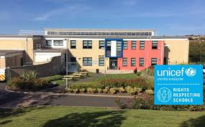
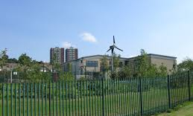
All About Starting School

Slide 2
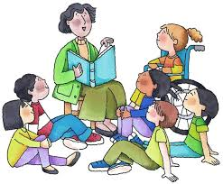
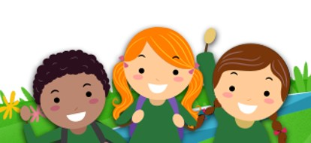
I wonder what it will be like when I start my new school, Harlow Green?
In September, children who are 4 and 5 years old will start their new schools. This will be very exciting!

Slide 3
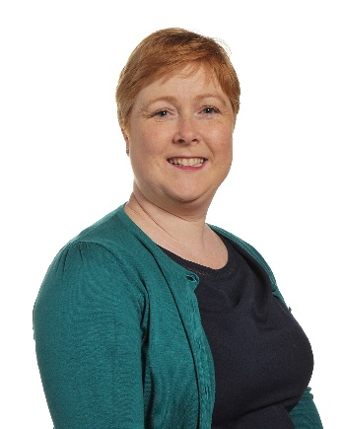
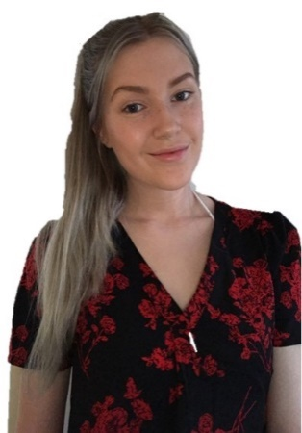
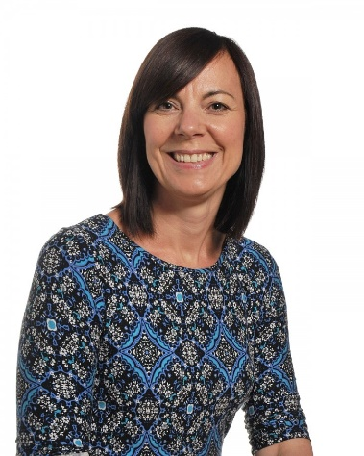
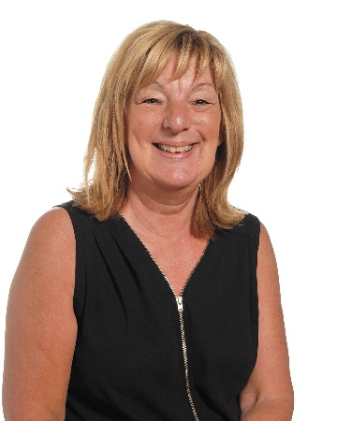
Who will my teachers be?
Hello, my name is Miss Bradshaw.
Hi, I am
Miss Nelson.
Hi, my name is Mrs Cunningham.
Hello, I am Miss Rodgers
Hi, my name is Mrs Anderson
In Reception you will get to know lots of new teachers.
They are all very friendly. The teachers will look after you and teach you new things when you are at school.

Slide 4
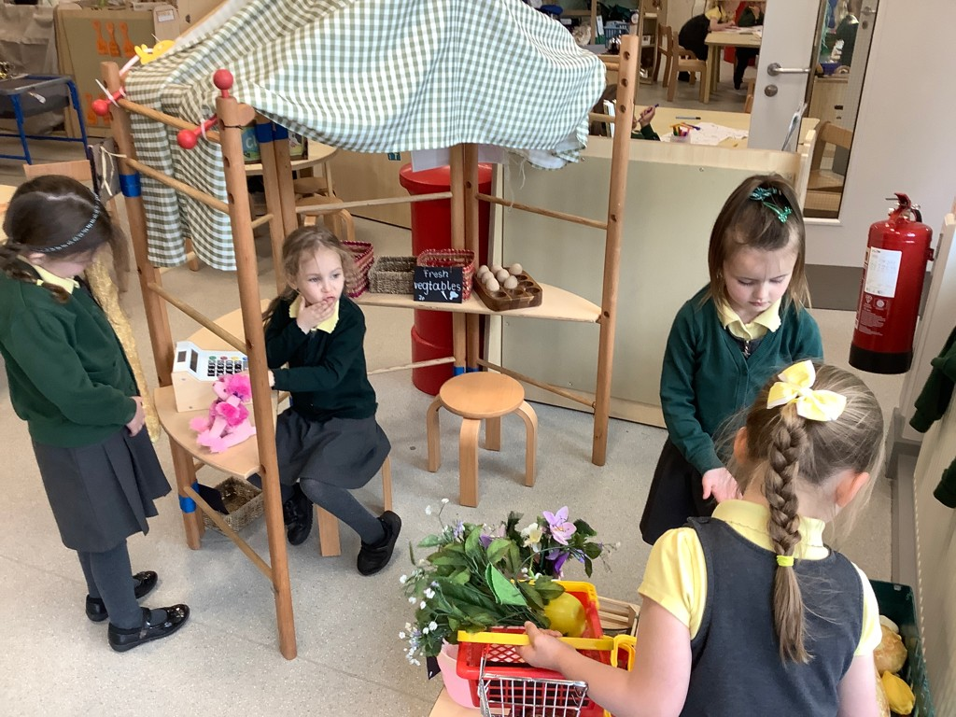
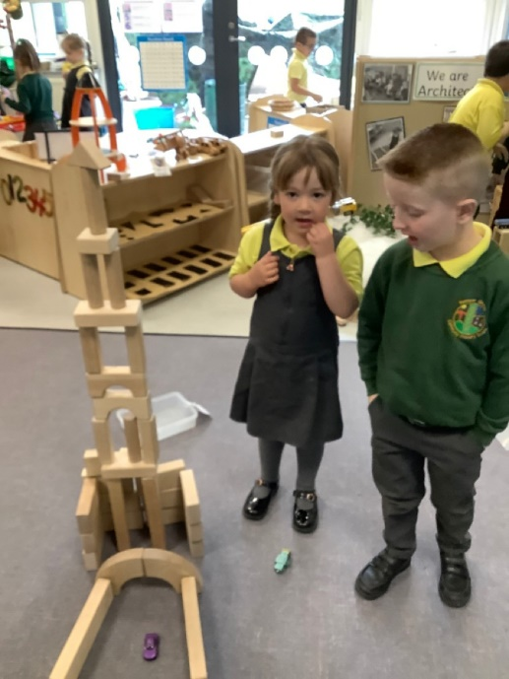
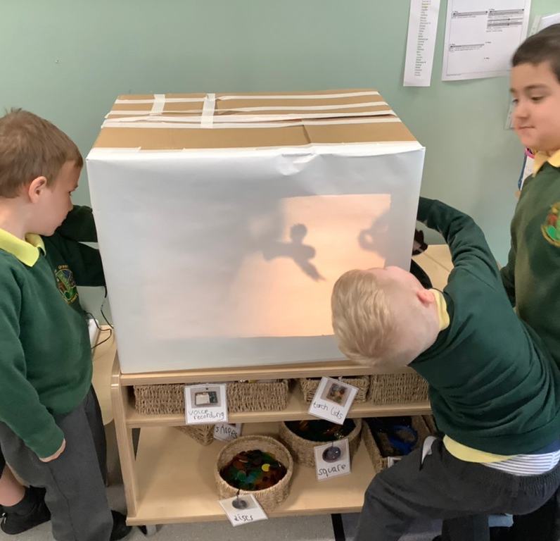
What will I wear when I go to school?
When children go to school, they have to wear special clothes called uniform. At Harlow Green children wear green, yellow and grey clothes to show which school they belong to.

Slide 5
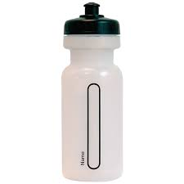
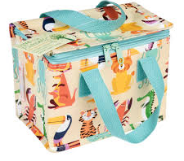
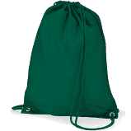
What will I need to bring to school, every day?
water bottle
packed Lunch, if you don’t have school dinners.
spare clothes
waterproof coat
reading folder
In the cloakroom, you will have your own peg with your name on so you can hang up your coat and bag. Your grown-up will put your name on all of your belongings that you bring to school.

Slide 6
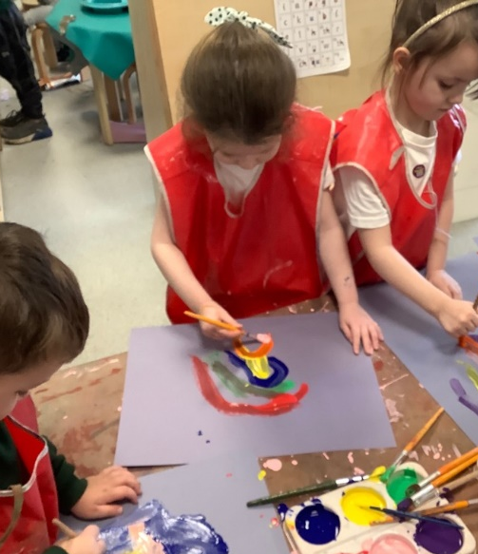
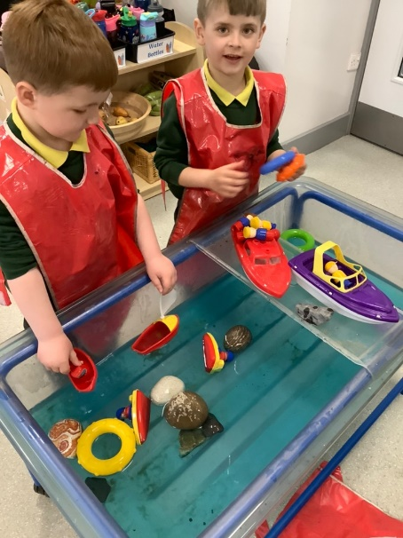
What will my classroom be like?
home corner
small world
painting area
water area
There are lots of interesting things to play with in the classroom.
You will be able to play in each area with your friends.

Slide 7
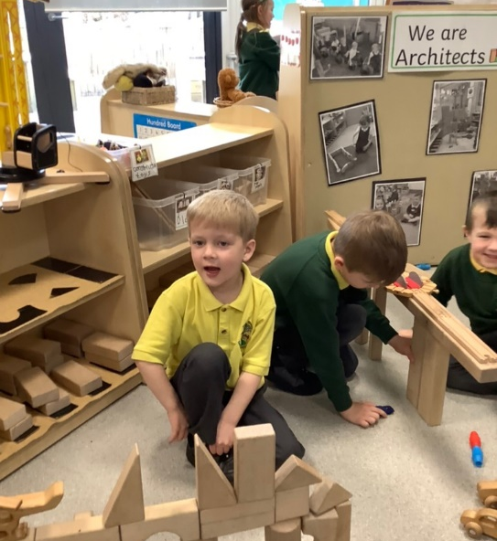
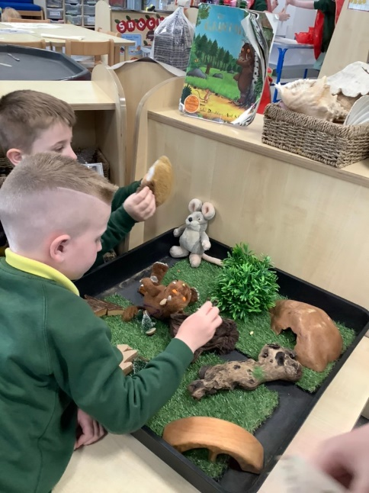
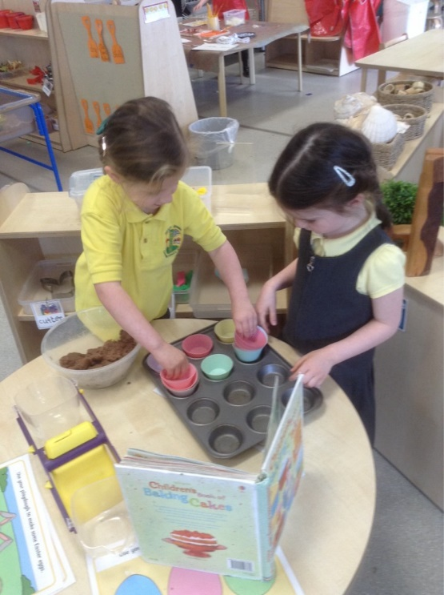
reading corner
construction area
dough area
small world area
When we play in the different areas we always share and help each other. After playing, we then tidy up so that other people can play later.

Slide 8
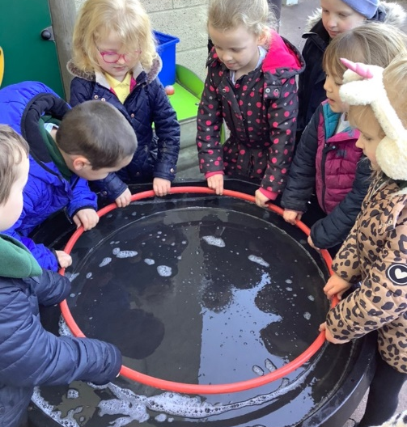
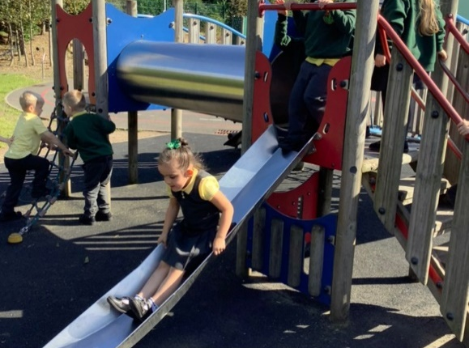
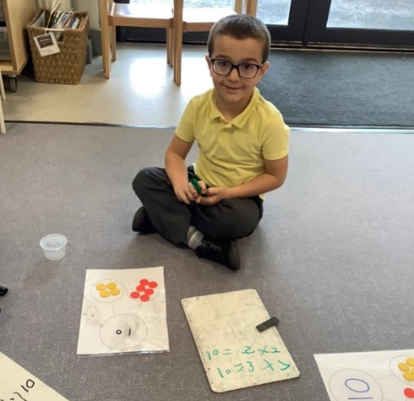
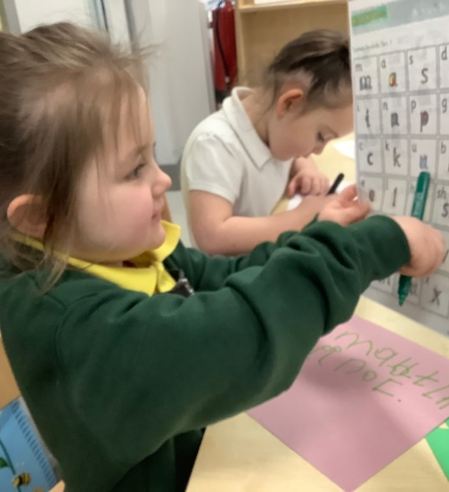
What will I do each day?
playtime
working with Friends
maths
reading and phonics
You will come to school every morning.
You will join in with lots of fun activities at school.

Slide 9
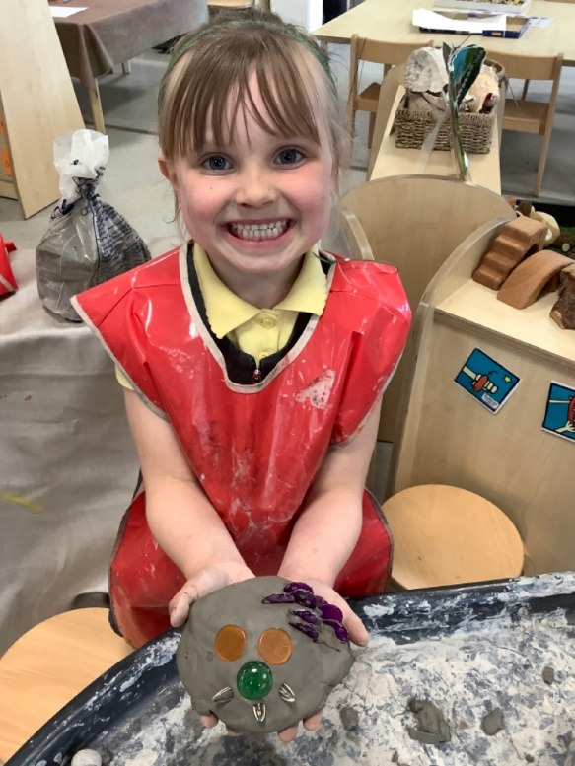
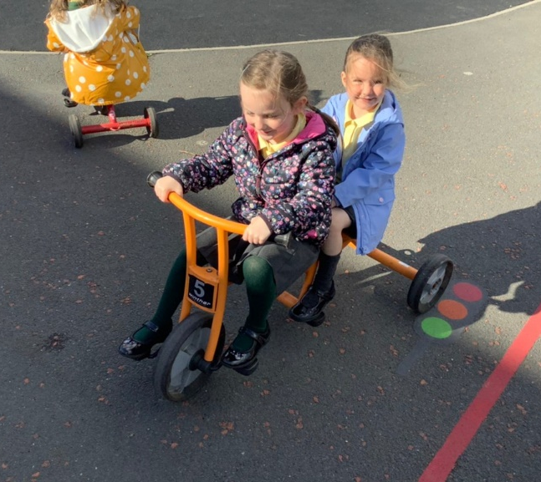
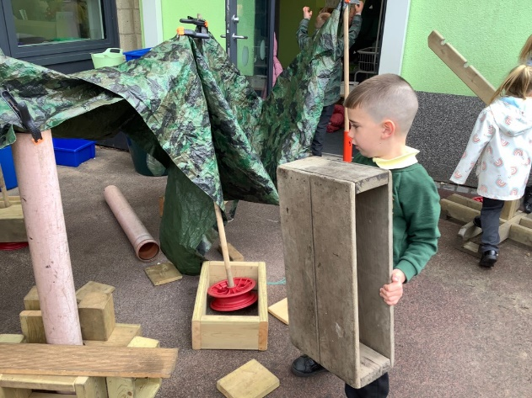
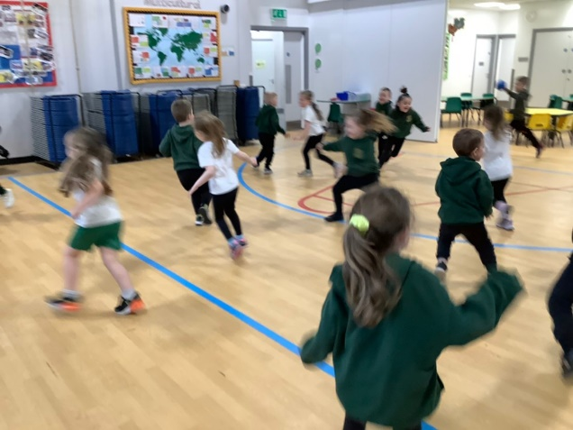
riding trikes
working outside in the garden
even more fun
keeping fit
At home time, your grown up will collect you from school.
School is open from Monday to Friday.
On Saturday and Sunday, we do not come to school.

Slide 10
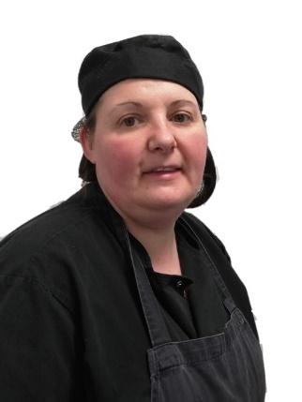
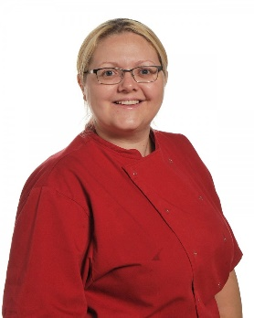
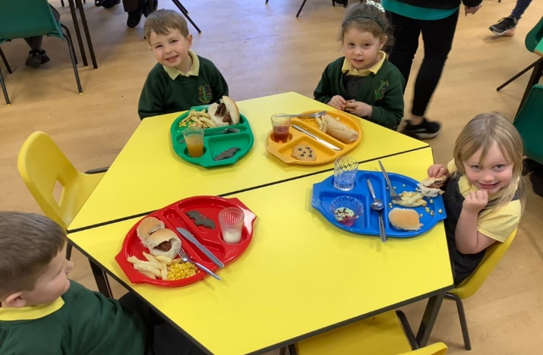
What will lunchtime be like at school?
We have lots of adults to help you at lunchtime.
At lunchtime, everyone is looked after by the dinner staff.
You will eat your dinner in the school hall with your friends and then go outside to play.

Slide 11
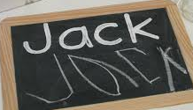
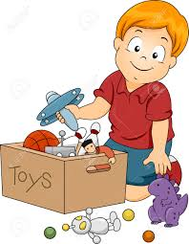
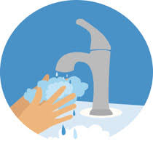
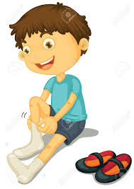
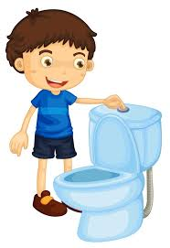
How can I be ready for school?
recognising your name
tidying your toys
washing your hands
getting dressed and putting on your coat and shoes
going to the toilet
using a knife and fork
There are lots of things that you can practise, before starting school, that will help you to be ready.

Slide 12
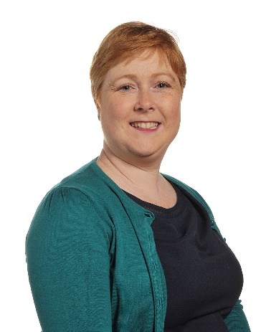
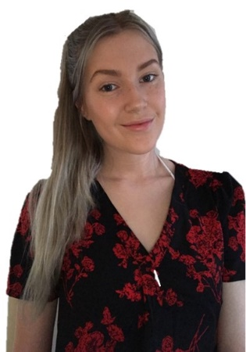
We hope you have enjoyed sharing this book and we look forward to meeting you soon!

